Slide 1
MACHINE LEARNING PROJECT
Group Members:
Meeth Yogesh Handa
Kshitij Mahajan
Milan Patel
Anthony Moreno
Audrey Hsien
Varun Kausika

Slide 2
1.
Problem Statement
Predicting white wine quality on a scale of 1-10 (Regression Problem)
Notes:
“What makes white wine 'good'?”

Slide 3
What combination of physicochemical traits make a White Wine “good” to a consumer?

Slide 4
About the Dataset: White Wine Quality
Portuguese "Vinho Verde" White Wine
Inputs are 11 physicochemical predictors decided through testing
Output is a quality score based on sensory data
We tested several feature selection methods to determine the most relevant variables.
Notes:
https://archive.ics.uci.edu/ml/datasets/wine+quality
P. Cortez, A. Cerdeira, F. Almeida, T. Matos and J. Reis.
Modeling wine preferences by data mining from physicochemical properties. In Decision Support Systems, Elsevier, 47(4):547-553, 2009.

Slide 5
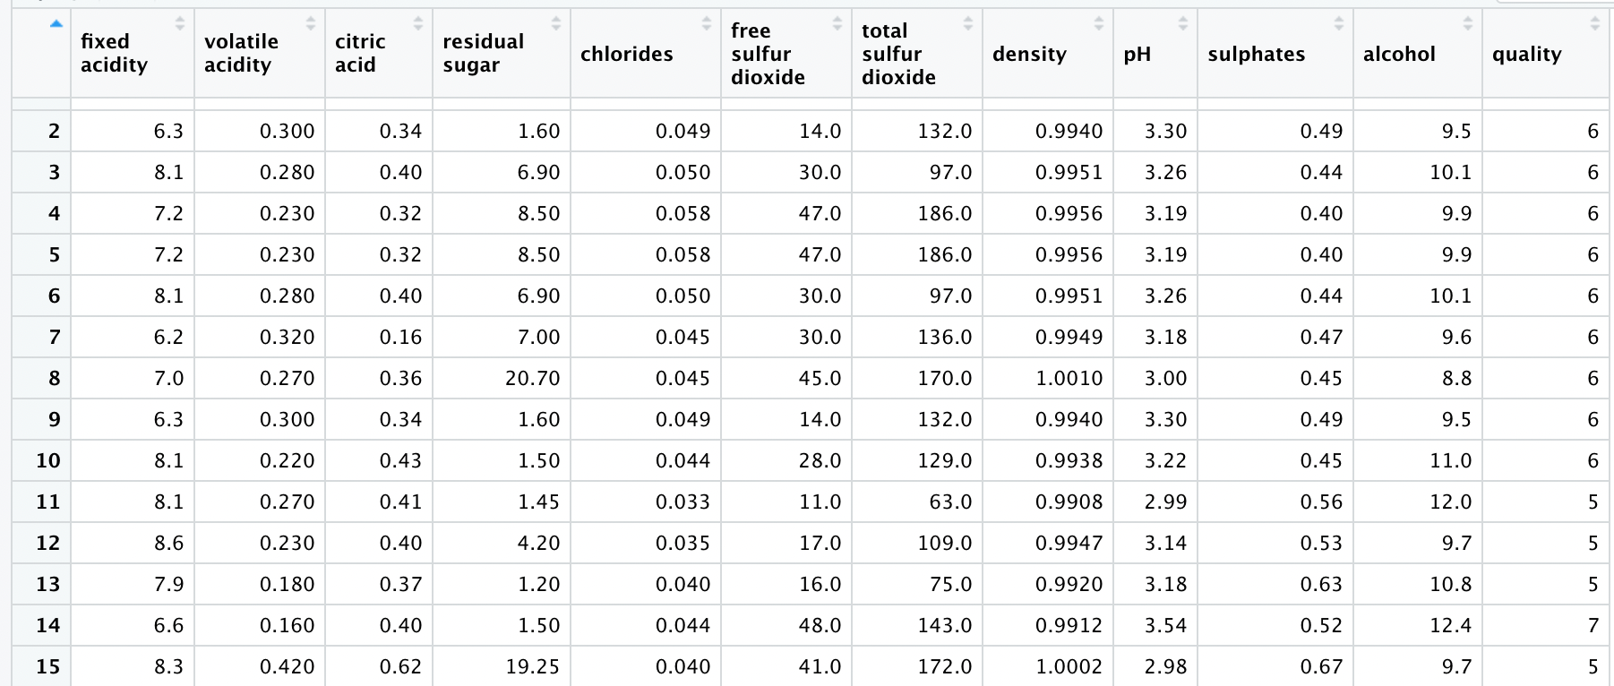
About the Dataset: White Wine Quality

Slide 6
Bagging +
Boosting
KNN
Neural Nets
Boruta+Simple Tree Models
Linear/
Multiple Regression

Slide 7
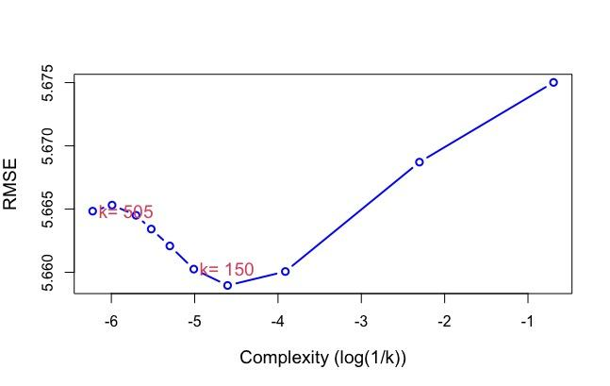
KNN
We had to increase the complexity fairly significantly to get a sizeable drop in RMSE
The complexity proved to be detrimental to the model after a K value of 150.
Lowest RMSE given at a K value of 150 nearest neighbors

Slide 8
Feature Selection
Boruta package feature selection
Based on random forests
Instead of over-pruning a version of the data set, all features are tested for relevance, regardless of how weak or strong
Gives a plot of all features based on importance
Notes:
https://archive.ics.uci.edu/ml/datasets/wine+quality
P. Cortez, A. Cerdeira, F. Almeida, T. Matos and J. Reis.
Modeling wine preferences by data mining from physicochemical properties. In Decision Support Systems, Elsevier, 47(4):547-553, 2009.

Slide 9
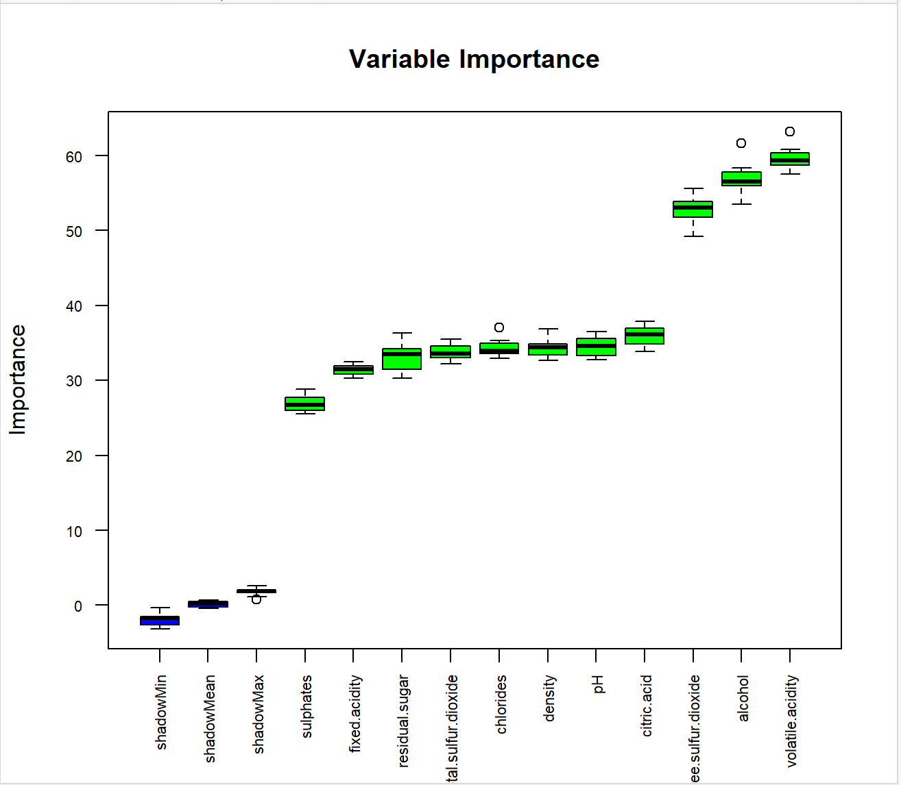
Boruta Feature Selection
Notes:
The idea of Boruta is that the features are competing amongst shadow variables - which are shuffled replicas of themselves.
When the Z-score associated with the model and the actual feature is much greater than that of the model and the shadow variable, we assign that feature a high importance.
(Z-score = average loss/ stdev)

Slide 10
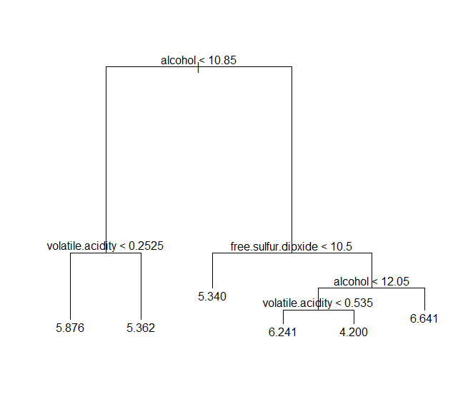
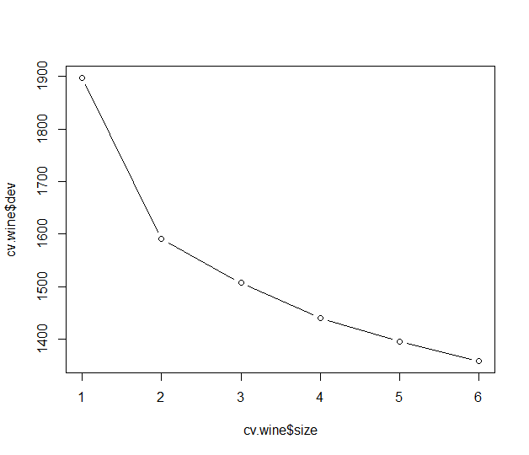
Regression Tree
Test RMSE = 0.75
Normal Regression Tree
Train: Test :: 1:1
Optimum tree size = 6 (selected by cross validation)
Pruning does not help in model

Slide 11
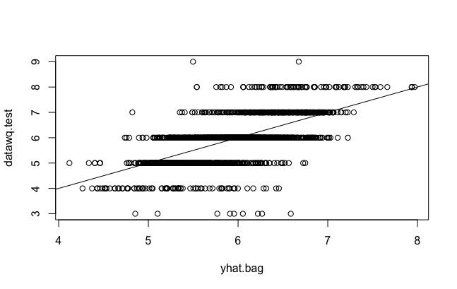
Bagging
For both testing and training data, RMSE reduced considerably after applying bagging compared to regression tree
The 3 most important variables are the same as before:
1) alcohol
2) volatile.acidity
3) free.sulfur.dioxide
Notes:
Bagging, also known as bootstrap aggregation, is the ensemble learning method that is commonly used to reduce variance within a dataset. In bagging, a random sample of data in a training set is selected with replacement—meaning that the individual data points can be chosen more than once.
We first applied bagging on the training data, where we saw that the RMSE was considerably reduced compared to the regression tree that we tried earlier. We had a similar finding for the test data as well.
Bagging gave us the same 3 most important variables:
1) alcohol
2) volatile.acidity
3) free.sulfur.dioxide
—-----------
Bagging:
Split observations up at random and then testing them. Builds out as many trees as columns.
https://www.ibm.com/cloud/learn/bagging#:~:text=Bagging%2C%20also%20known%20as%20bootstrap,be%20chosen%20more%20than%20once.

Slide 12
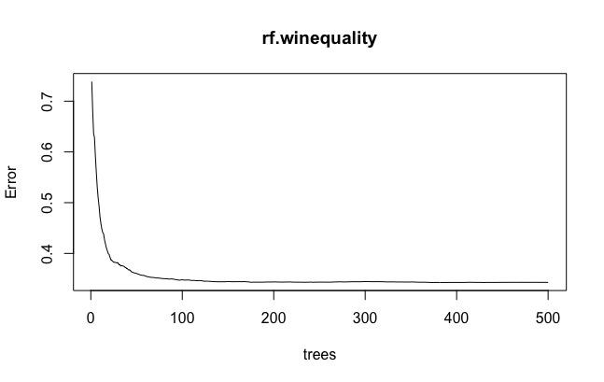
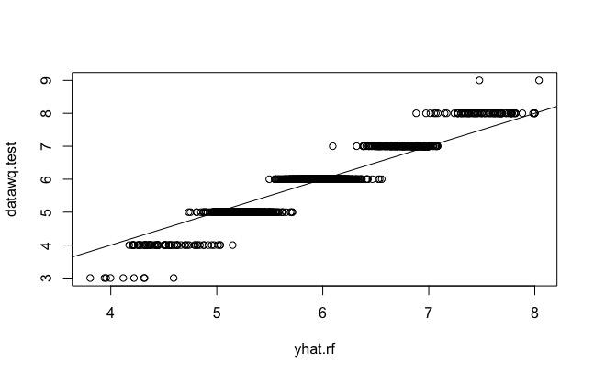
Random Forest
The MSE reduces massively on test data after random forest
After applying boosting data and parameters, Test MSE is still the best for random forest algorithm.
Similar to knn, 150 trees gives the lowest error
Random Forest
Output
Notes:
Next, we tried the random forest algorithm, which is considered an extension of the bagging method, using both bagging and feature randomness to create an uncorrelated forest of decision trees.
Random forests or random decision forests is an ensemble learning method for classification, regression and other tasks that operates by constructing a multitude of decision trees on the training set. The outcome is based on the predictions of the decision trees by taking the mean of the output from various trees.
Increasing the number of trees increases the precision of the outcome
And using random forests can reduce the risk of overfitting.
So when we tried random forest on the training and test data, we saw a fantastic improvement as the Mean Square Error (MSE) reduced significantly after implementing random forest, especially on the test data.
After applying boosting data and boosting parameters, Test MSE is still the best for random forest algorithm.
Similar to knn, you can see in the top right graph that the error levels out at around 150 trees
—------------
Everytime you build out the tree, only consider 4 columns.

Slide 13
Boosting
Boosting is an ensemble learning method that combines a set of weak learners into a strong learner to minimize training errors
In boosting, a random sample of data is selected, fitted with a model and then trained sequentially—that is, each model tries to compensate for the weaknesses of its predecessor.
With each iteration, the weak rules from each individual classifier are combined to form one, strong prediction rule.
In our project, we have implemented boosting in 2 ways: normal boosting and XGBoost.

Slide 14
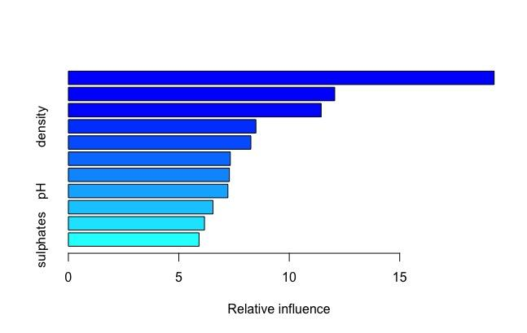
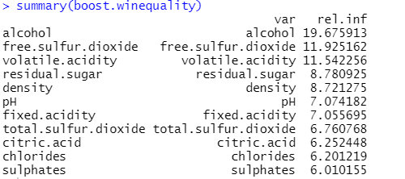
Variable influence in boosting:

Slide 15
XGBoost
Stands for eXtreme Gradient Boosting
It is a machine learning library which can be used to implement boosting parallelly.
Using XGBoost leads to faster execution speeds as well as increased model performance in structured data sets.
In Boosting one has to take care of 3 parameters: the number of trees, the size of each tree and the crushing factor.

Slide 16
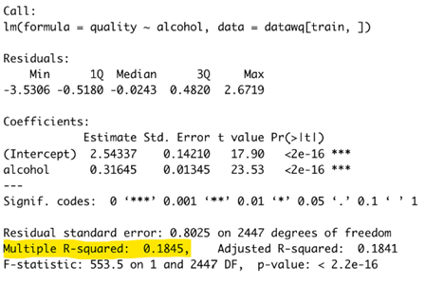
Simple Linear Regression
Using a forward stepwise selection method, the 3 best variables for a multiple linear regression were found to be alcohol content, volatile acidity, and residual sugar
For simple linear regression, only Alcohol was used for the predictor
RMSE: 0.79
Notes:
We can see from the highlighted section that the R squared value is low (closer to zero rather than 1), meaning the regression is a poor fit of the data. We can see that the Root Mean Squared Error is also high, meaning that the model performs poorly when predicting out of sample

Slide 17
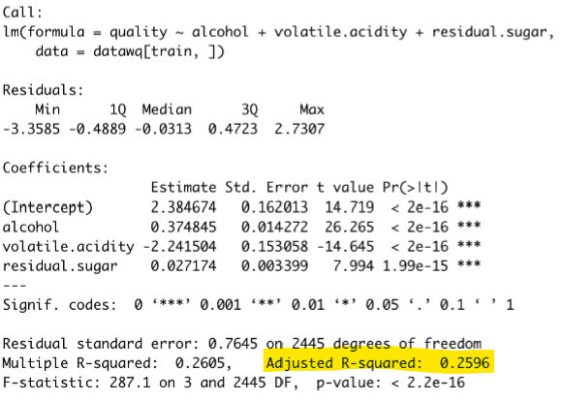
Multiple Linear Regression
Using forward stepwise selection, the 3 best variables for a multiple linear regression were found to be alcohol content, volatile acidity, and residual sugar
In this model all of the top three predictors were used to fit the data
RMSE: 0.76
Notes:
We can see from the highlighted section that the R squared value is low as well, meaning this regression is also a poor fit of the data.
Here we are looking at the adjusted R squared values because The R square values always increase when you take more variables in linear regression so we check adjusted r square for multiple regression which gives us a more accurate picture of the error
And we can see that the Root mean squared error is also high
From the two linear regression models, its clear to see that the relationship between the output variable and predictors isn’t linear, which we expected from looking at the scatter plots of each of the variables used with the output

Slide 18
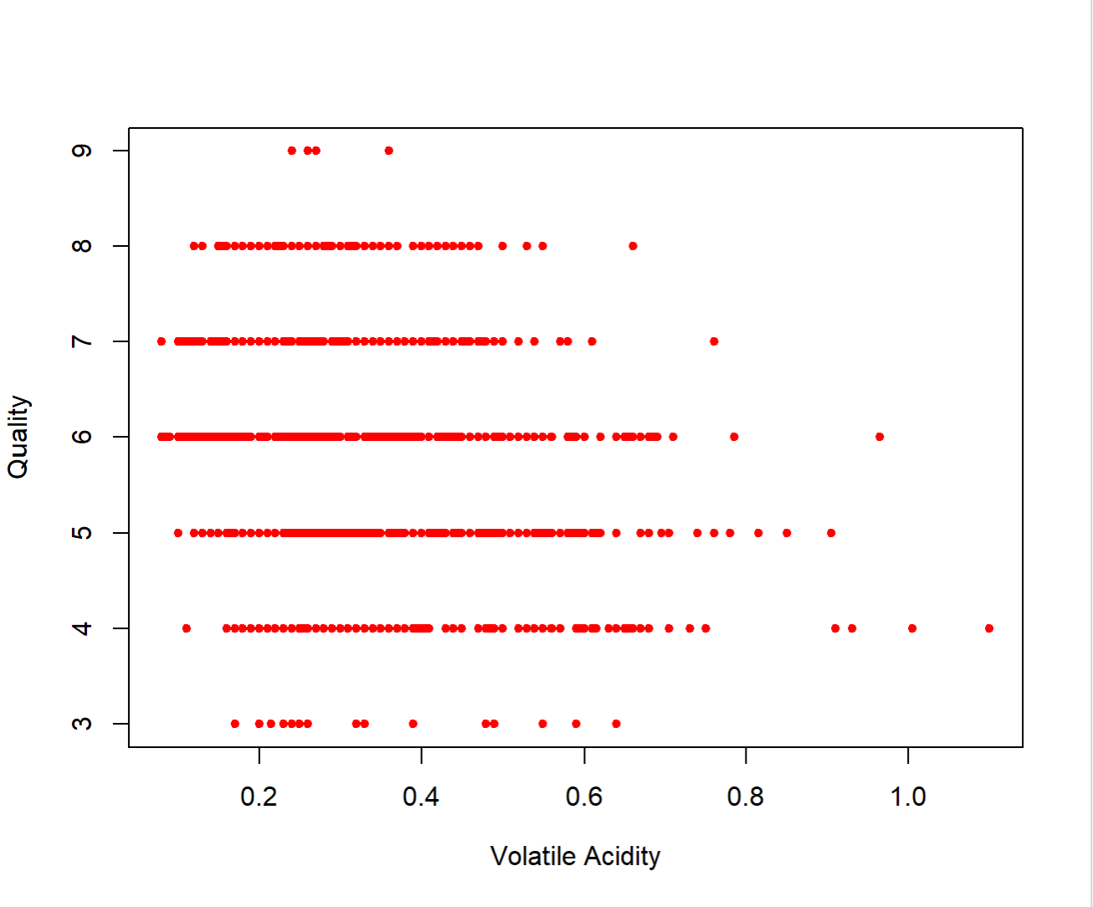
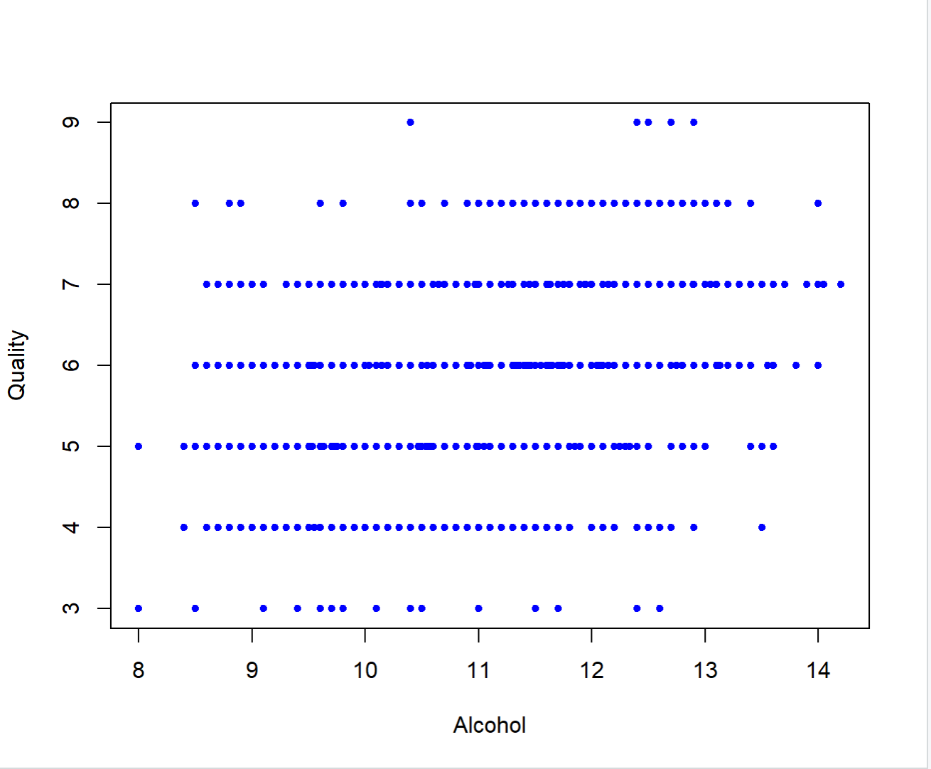
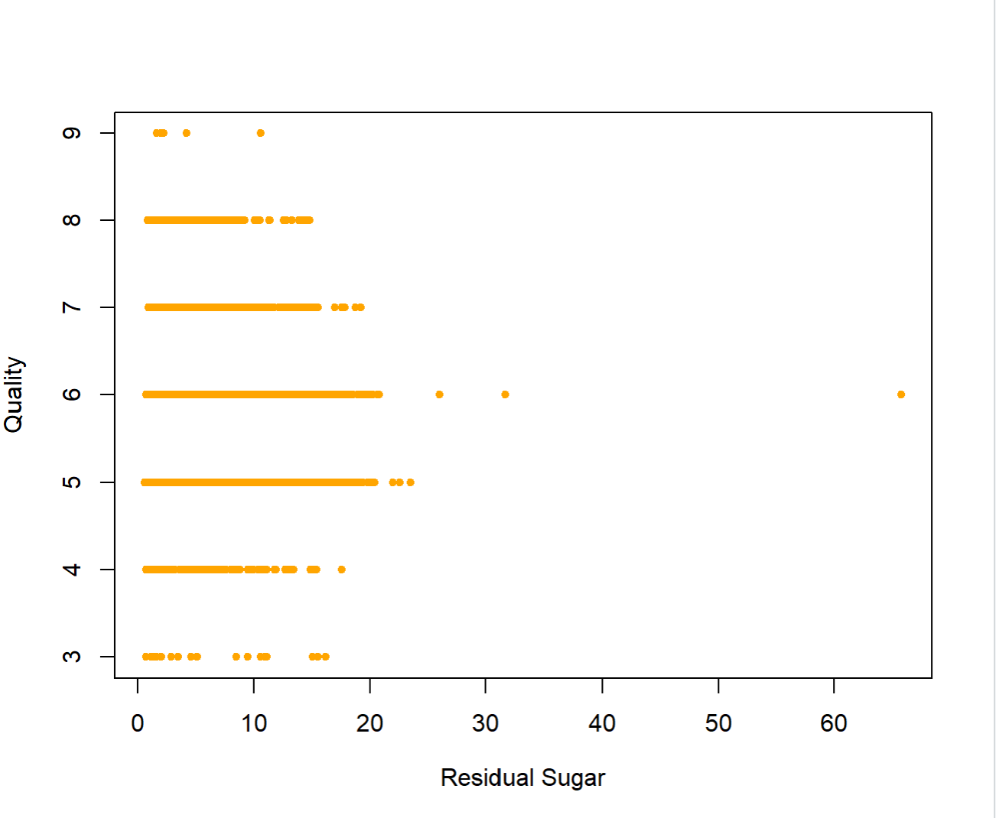
Linear Regression Scatter Plots
Notes:
From the two linear regression models, its clear to see that the relationship between the output variable and predictors isn’t linear, which we expected from looking at the scatter plots of each of the variables used with the output
Seen here, but we can see a slight upward trend in that the white wines with slightly higher quality tend to have alcohol content greater than around 11

Slide 19
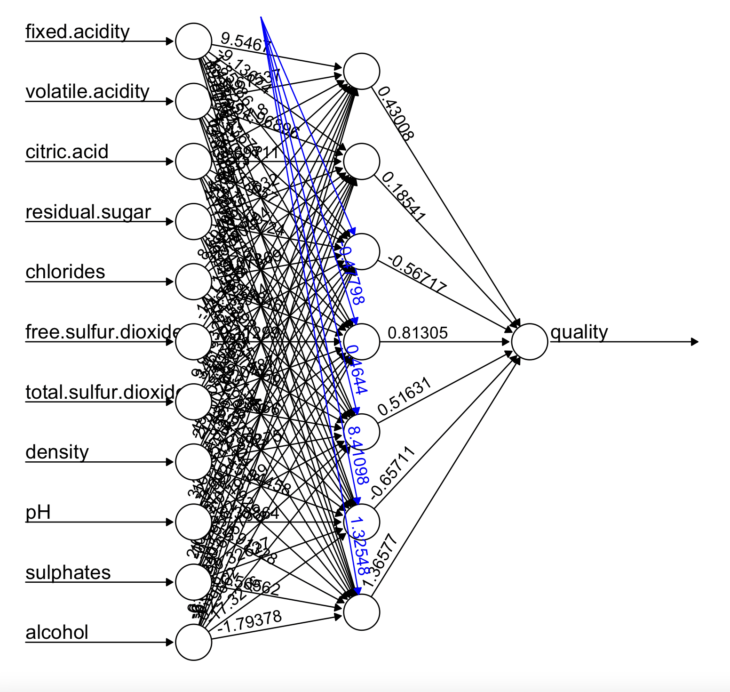
Neural Net
To fit a neural network on our data, The first step is to scale the wine quality dataset using min-max normalization.
The scaled data is used to fit the neural network. We visualize the neural network with weights for each of variable.
Our model has 7 neurons in its hidden layer. The black lines show the connections with weights. The weights are calculated using the backpropagation algorithm. The blue line displays the bias term.
RMSE: 0.67
RMSE: 0.66

Slide 20
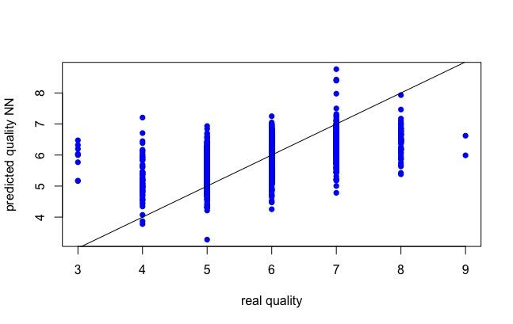
Neural Net Output
We predicted the quality using the neural network model. The Predicted quality was scaled and needed to be transformed in order to make a comparison with the real quality value
We also compared the predicted quality with real quality using visualization.
RMSE calculated was significantly larger than RMSE of RF and XGBoost models and can be reduced further by adding more hidden layers and neurons in each hidden layer.
Requirement of high computing power is a downside of Neural Networks.

Slide 21
Results
Model | RMSE value
KNN | Lowest RMSE at k=150
Regression Tree | 0.75
Bagging | 0.63
Boosting | 0.68
Linear Regression | 0.76
Multiple Linear Regression | 0.79
Random Forest | 0.25
XGBoost | 0.45
Neural Network | 0.66
Random Forest model gave the lowest RMSE value
Notes:
Audrey

Slide 22
Questions?

